Slide 1
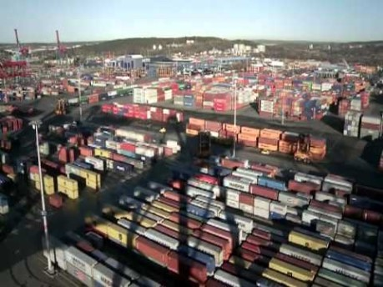

Slide 2
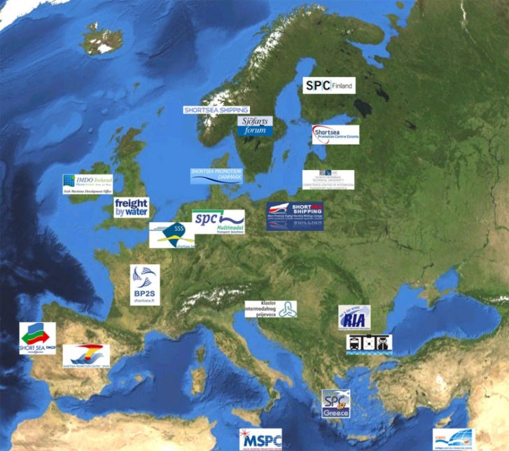
Ports and infrastructure
European Commission - Ports in Europe
319 harbors
83 core network ports
50% increase by 2030
74% of third country goods
Varying capacity and efficiency
Major Ports and infrastructure
Short sea shipping
Gas and infrastructure
Core network for gas
Fuel
Environmental performance

Slide 3
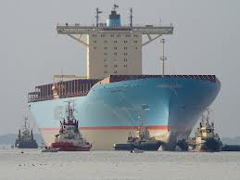
Ports and infrastructure
Development
Larger wide Port and infrastructure
Profound
Load and unloading capacity
Infrastructure to and from port
Landström

Slide 4
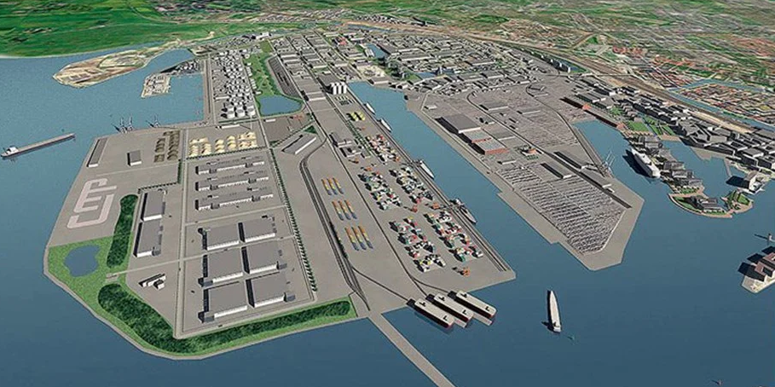
Ports and infrastructure
Concept
This is how the size of the harbor is measured
Number of berths
How many ships can fit
Quay length
Port depth
This is how the port's capacity is measured
Number of tons of goods
Bulk
Number of roro units
Number of teu
Twenty-foot equivalent unit

Slide 5
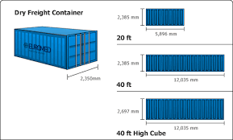
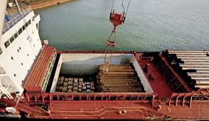
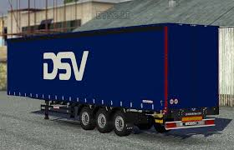
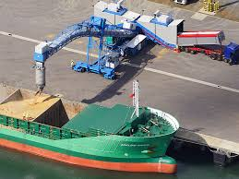
Ports and infrastructure
20ft container
40ft container
1 teu = 1 20ft
RORO unit
Bulk

Slide 6

Ports and infrastructure
Ports of Stockholm
Owned by the City of Stockholm
Ports
Chapel cut
Stockholm
Nynäshamn
Operation
Ro/Ro
Bulk
Container
Cruise ship
Archipelago traffic

Slide 7
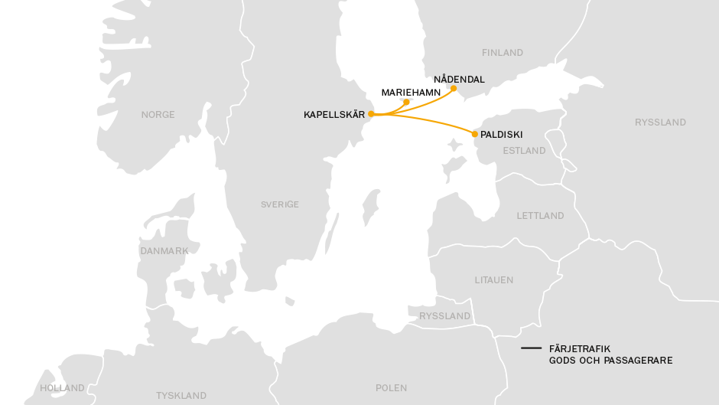
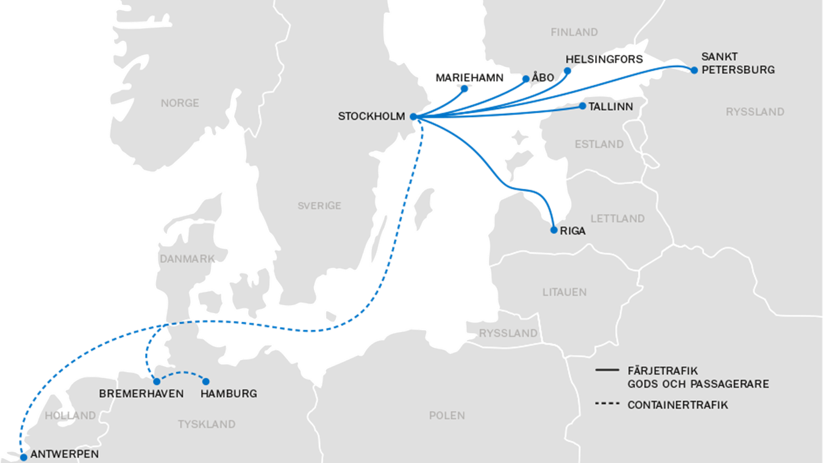
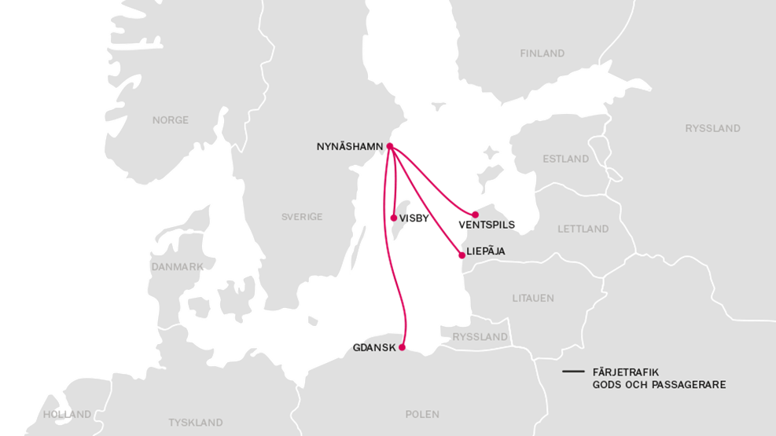
Ports and infrastructure
Chapel cut
DFDS Seaways
Finnlink
Viking Line
Stockholm
City garden
The host port
Freeport
Nynäshamn
Visby
Gdańsk
Ventspils
Leipaja

Slide 8
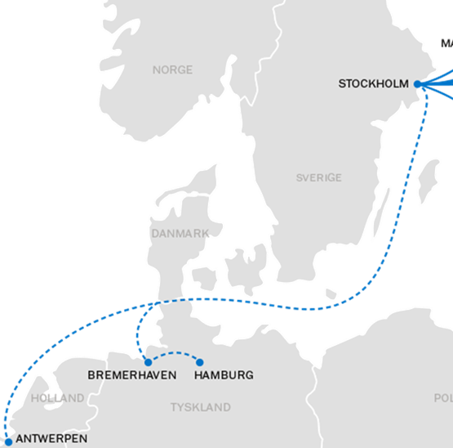
Ports and infrastructure
Stockholm's Frihamn container terminal
Operated by terminal operator Hutchinson
Feeder ship
Weekly service
Antwerp
Rotterdam
Hamburg
Number of 20' containers ( teu ) in 2019
60,000
Rail connection
Cooperation with Green Cargo

Slide 9
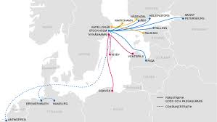
Ports and infrastructure
Stockholm's Ports in numbers
Quantity of goods
9.3 million tonnes of goods
Number of teu
60,000
Number of roro units
About 100,000
Bulk
2 million tons

Slide 10
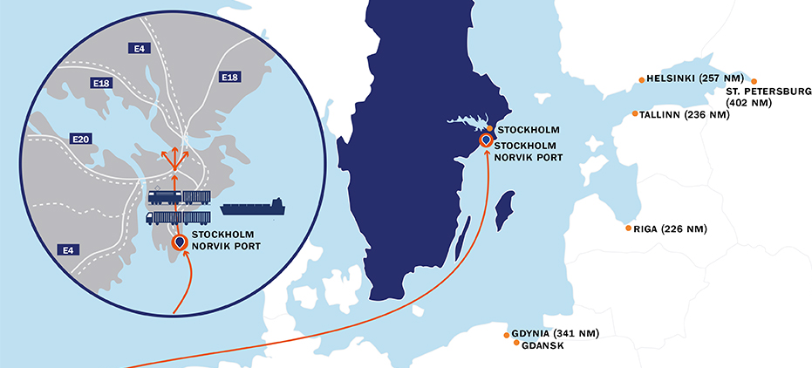
Ports and infrastructure
Nynäshamn
Stockholm Norvik Harbour
https://www.stockholmshamnar.se/om-oss/nyheter/2020/nu-ar-hela-stockholm-norvik-hamn-oppen/
Capacity in term 300,000 ( teu ) 20'containers

Slide 11
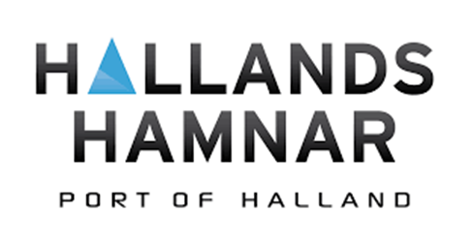
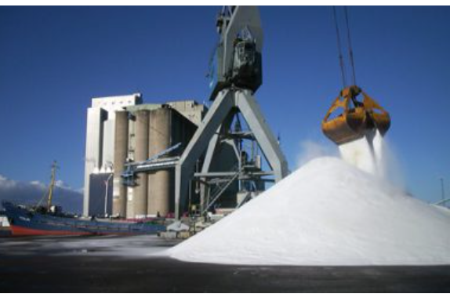
Ports and infrastructure
Halland's Ports
Halmstad
Quay length: 3 km
Quay depth: from 6.5-11 m, 4 RoRo ramps.
Rail commutes: Daily departures Mälardalen/Norrland.
Cars
Container
Bulk
Grain, glass raw materials, fertiliser, salt and gypsum.
Varberg
Quay length: 1.4km
Quay depth 10 m
Project load
Forest products

Slide 12
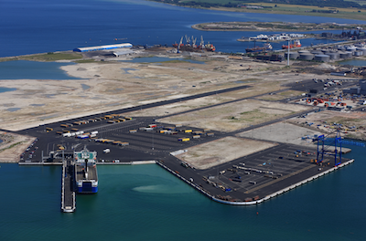
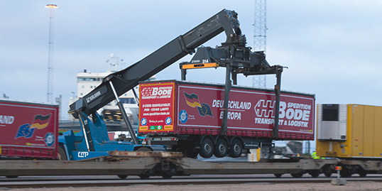
Ports and infrastructure
Malmö Harbor is owned by Malmö Stad
The business is run through
Malmö Port, municipal corporation and CMP Copenhagen
Merger of Malmö port and Copenhagen port
North Harbour
RoRo
RoPax

Slide 13
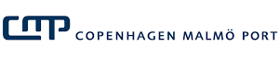
Ports and infrastructure
CMP in numbers
Quay length
16.5 km
Number of berths
16
Quantity of goods
15.5 million tonnes per year
Mostly bulk
Garbage
Cars
2 million Toyotas per year
RORO units
About 300,000 per year

Slide 14
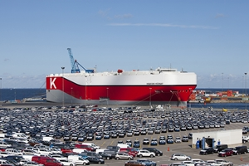
Ports and infrastructure
CMP Copenhagen Malmö Port
Freeport
Cars
Hub for cars to the Baltic Sea region
About 20 car brands
Terminals
Copenhagen terminal
Toyota Nordic Hub Terminal
Autolink Terminal
Skandia Transport Terminal

Slide 15
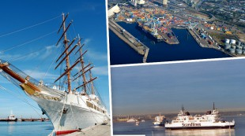
Ports and infrastructure
Helsingborg Harbour
Municipal corporation
The port in numbers
468,000 ro ro units
Call with ferries 32 122
274,000 20' containers ( teu )
8.2 million tonnes of goods
53% Container
20.5% Car ferries
11.3% Bulk
15.2% Stock
About 25 destinations
14 train shuttles

Slide 16

Ports and infrastructure
Fruit
Shipping company McAndrews
Weekly service/two The harbor and infrastructure
Bilbao – Thamesport – Helsingborg – Gdynia – Teesport – Thamesport – Bilbao
250 containers per call
Chiquita
Shipping company MSC
Weekly service

Slide 17
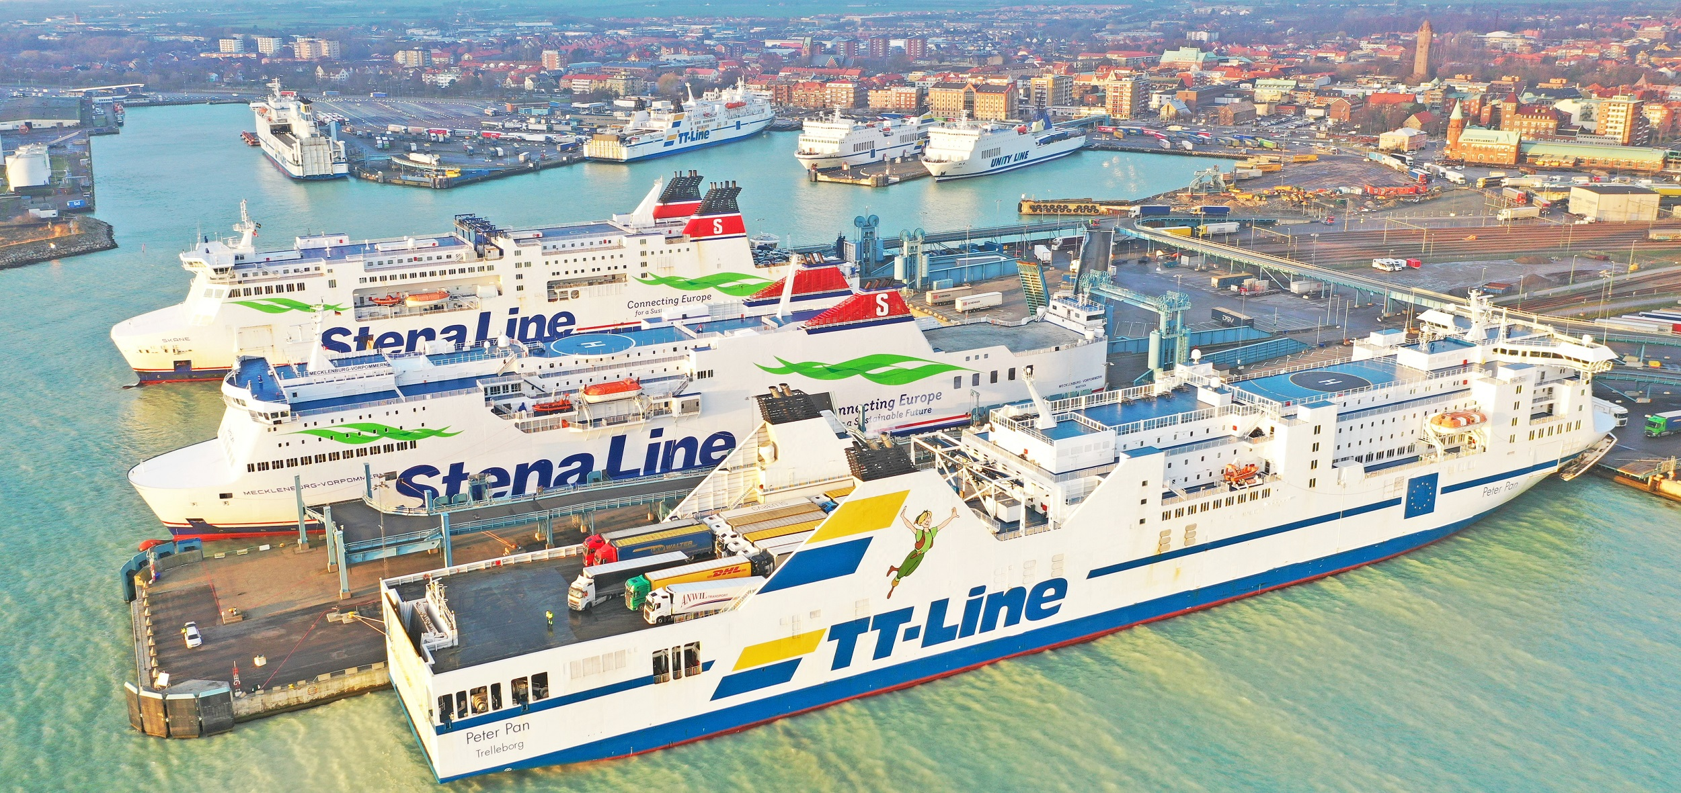
Ports and infrastructure
Trelleborg Harbour
Sweden's largest Ro Ro port
773,000 ro ro units
Unity Line
Trelleborg – Swinoujscie
TT-Line
Travemünde
Rostock
Swinoujscie
Klaipeda
Stena Line
Rostock
Train ferry
Trelleborg - Rostock
Helsingborg Harbour
468,000 ro ro units
Helsingborg – Helsingør
Departure every 20 minutes
Notes:
15 arrivals and 15 departures) creates an efficient link between the port and the four ports of Travemünde, Rostock, Swinoujscie and Klaipeda.

Slide 18
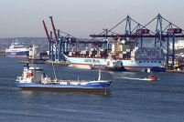
Ports and infrastructure
Port of Gothenburg – Owned by the City of Gothenburg
The port in numbers
• 885,000 containers TEU
• 560,000 ro/ro units
• 276,000 new cars
• 1.7 million passengers
• 21.1 million tonnes of oil
• 41 million tonnes of goods

Slide 19
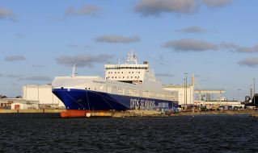
Ports and infrastructure
Port of Gothenburg
The business is run by
Gothenburg Ro/Ro Terminal
DFDS Seaways
Cobelfreight
Transatlantic
APM Maersk Terminals
Container
Logent Ports and Terminals
Cars

Slide 20
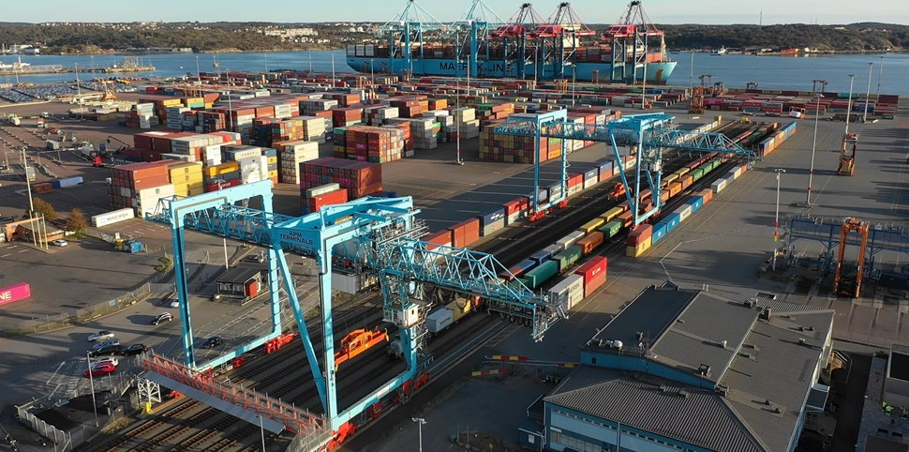
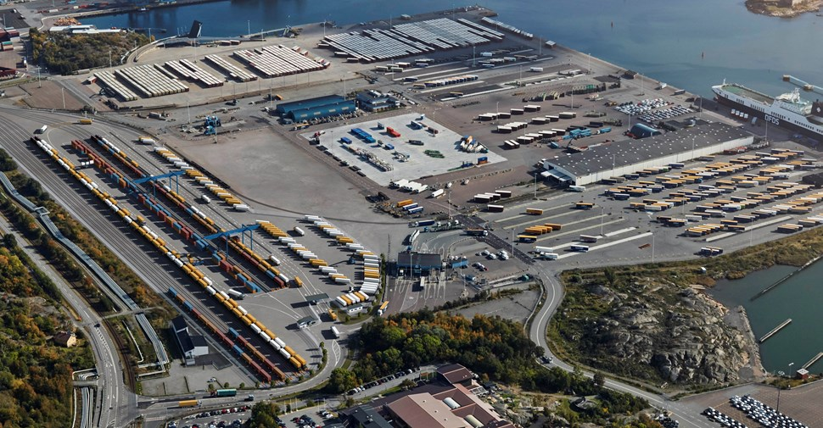
Ports and infrastructure
Combi traffic
Port of Gothenburg
70% of unloaded containers
Further by train
About 20% RO RO units
The container terminal in Gbg port
Gothenburg RORO terminal

Slide 21
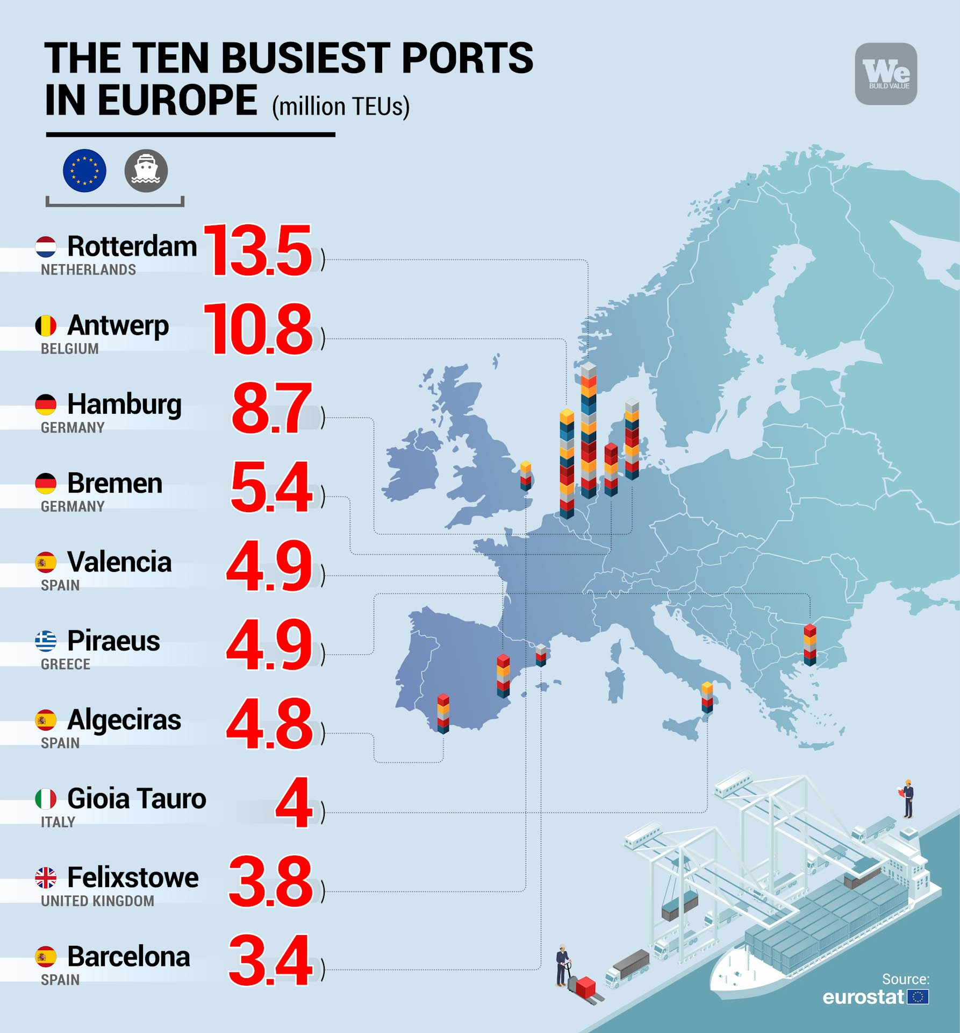

Slide 22
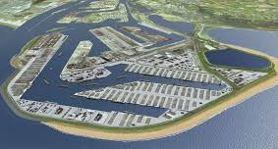
Ports and infrastructure
Rotterdam
Europe's largest port per tonne handled
470 million tons
13.5 million teus
350 million consumers
Inland waterways
Notes:
Gbg 41 million tons

Slide 23
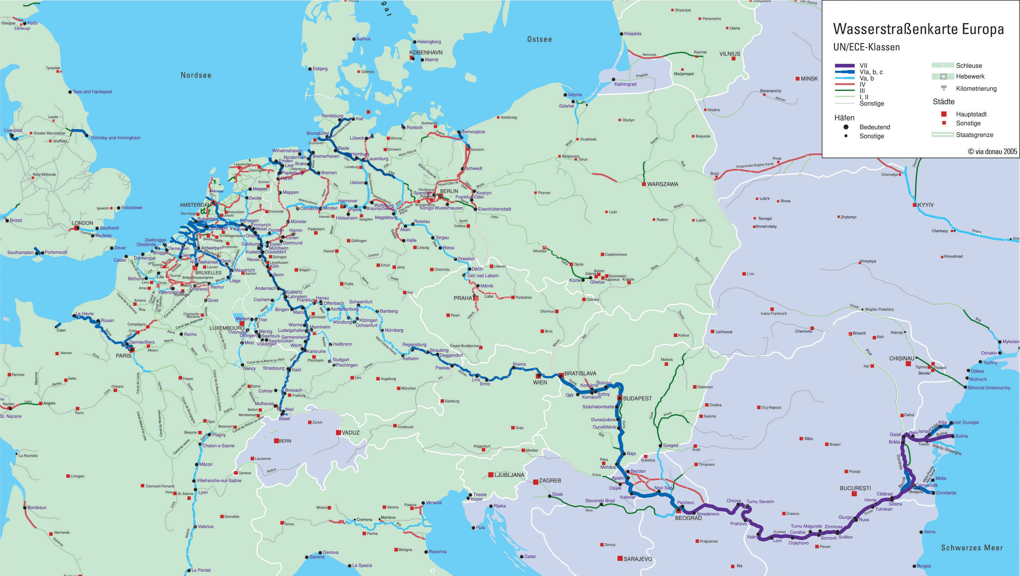
Ports and infrastructure
100,000 ships operate between the port of Rotterdam and Europe's inland waterways
30,000 ships use the port of Rotterdam abroad
http://www.portofdortmund.com/fileadmin/img/englische_Fassung/73_europa__ische_wasserstrassenkarte.jpg

Slide 24
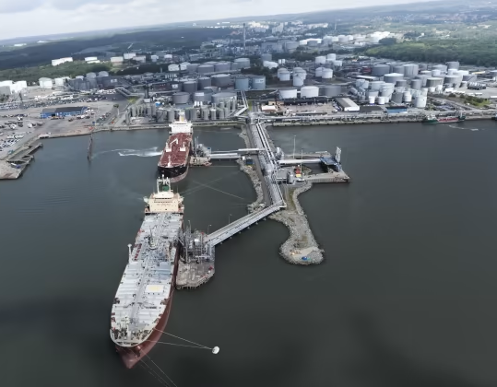
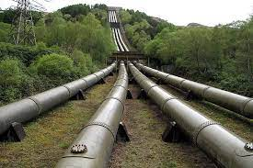
Pipelines

Slide 25
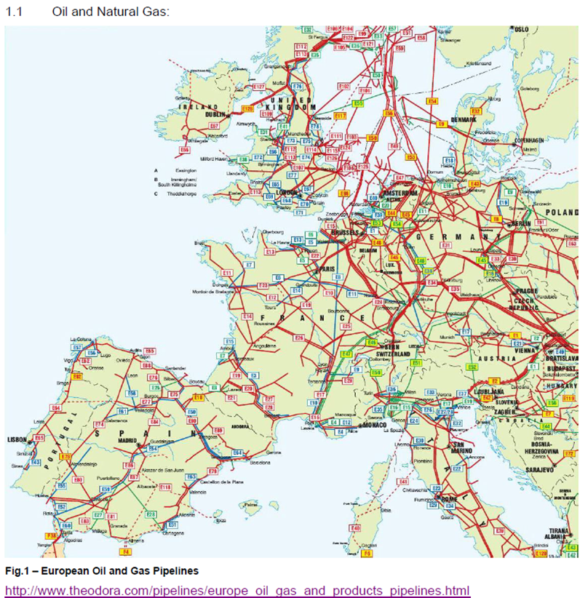
Pipelines
Pipelines for oil and gas in Europe
About 200,000km
The length of Sweden is 1572 km Treriksröset in the north to Smygehuk in the south

Slide 26
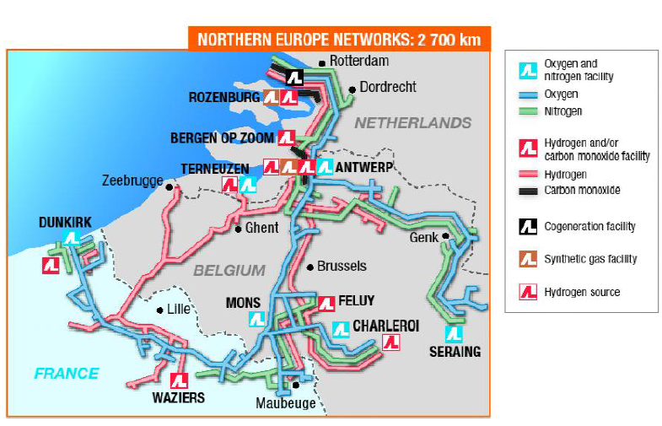
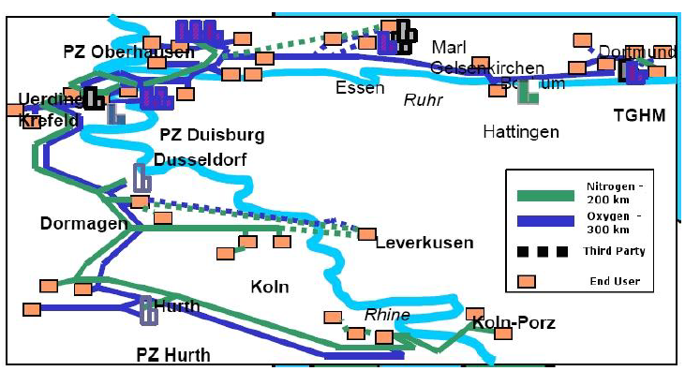
Pipelines

Slide 27
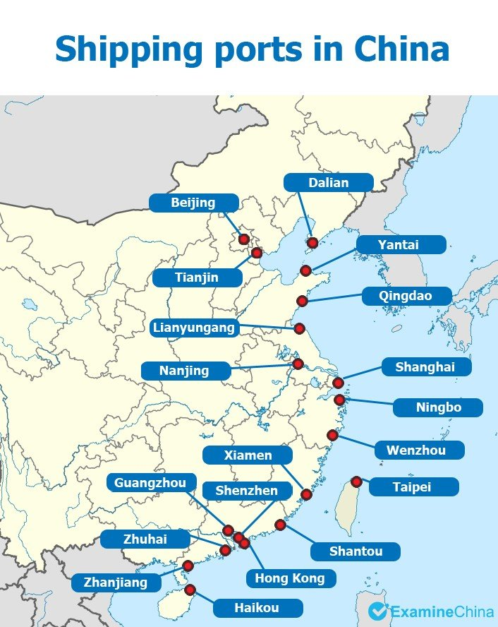
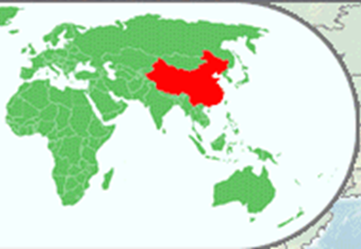
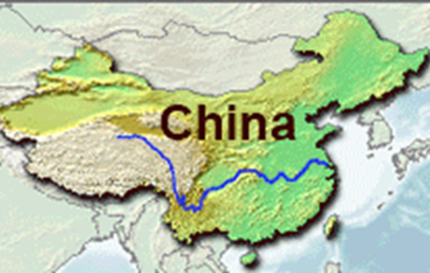

Slide 28
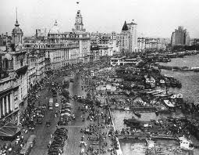
Ports and infrastructure
Shanghai Old Container Port
Water depth
Low handling capacity
Entry and exit process

Slide 29
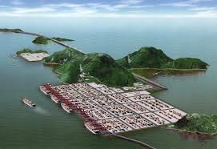
Ports and infrastructure
Shanghai – Yangshang Deepwater Port 2005
2010 world's largest port 29 million teus /year
2021 43.6 million ( teu ) 20' containers/year
Average 80,000 teus per week
Record 143,000 teus per week
Shengdong International Container Terminal
156 cranes , 23 m wide
43 berths

Slide 30
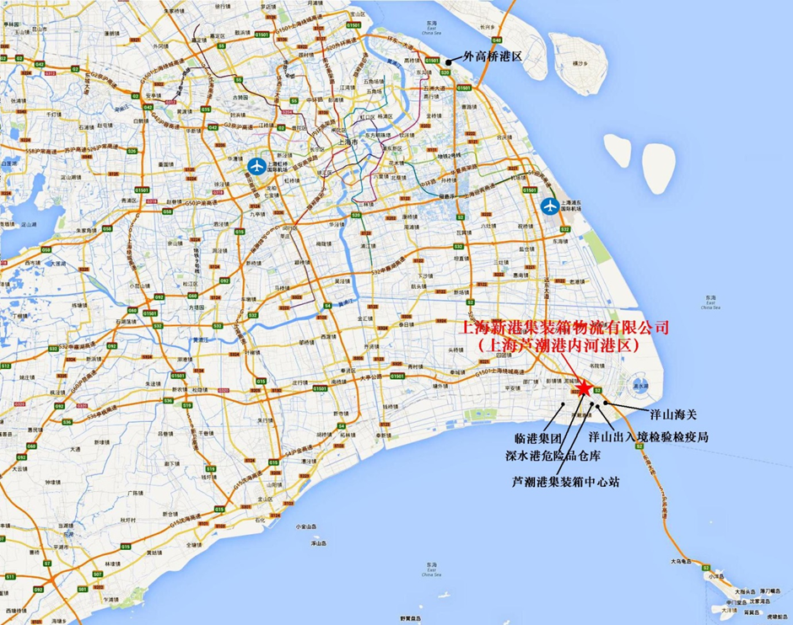
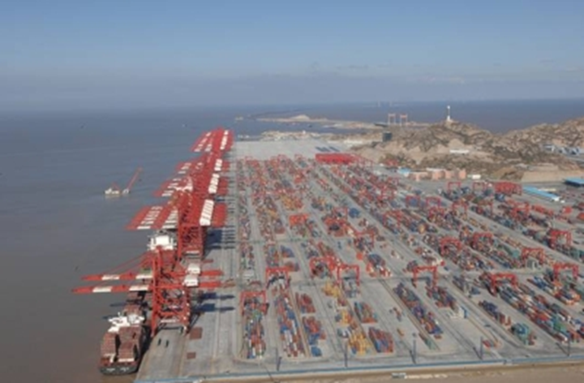
Ports and infrastructure
Notes:
34 st kranar, 23 m bred

Slide 31
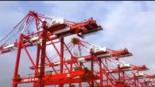

Slide 32
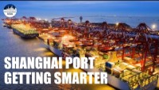

Slide 33

Ports and infrastructure
Notes:
Kinas längsta flod, som med sina 6 300 kilometer är den längsta floden i Kina
och Asien, samt världens tredje längsta flod (efter Nilen och Amazonfloden)

Slide 34
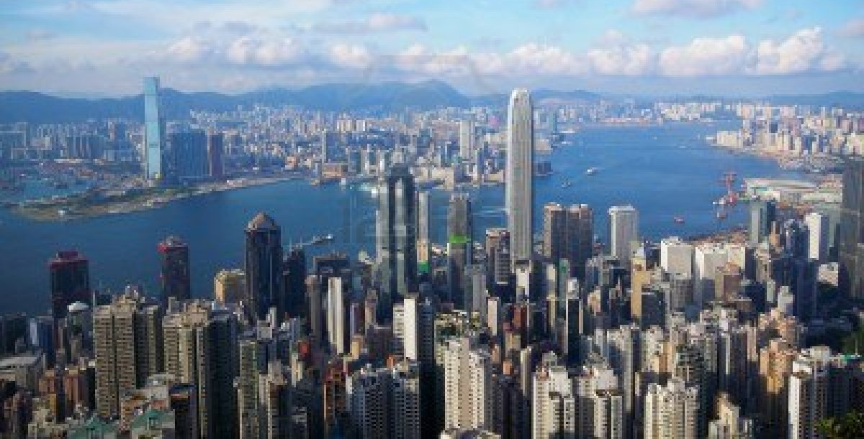
Ports and infrastructure
50,000 rivers
Huangpu River
Yangtze River
Nanjing
Wuhan
Chongqing
Pearl River Delta
Xijiang River
North River
East River
Tanjiang River

Slide 35
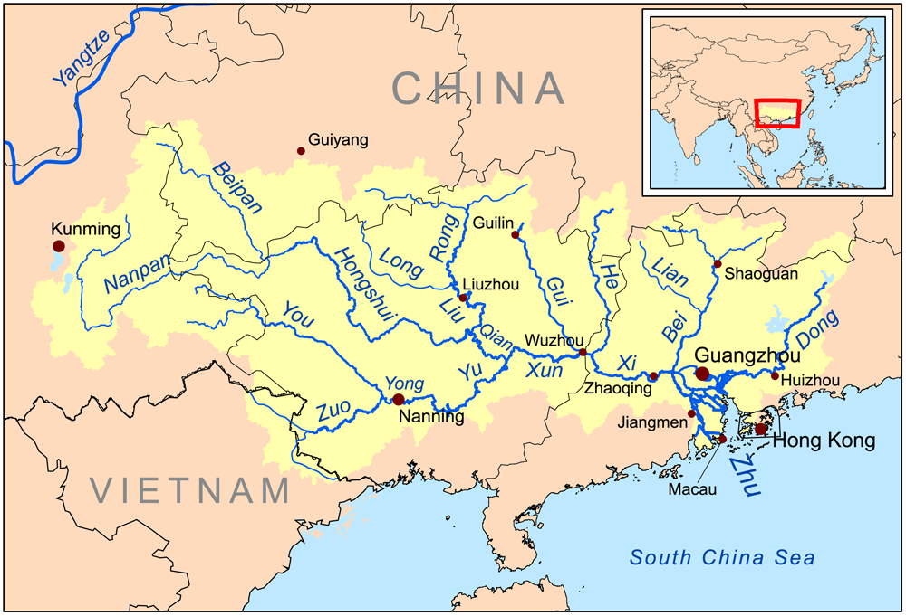
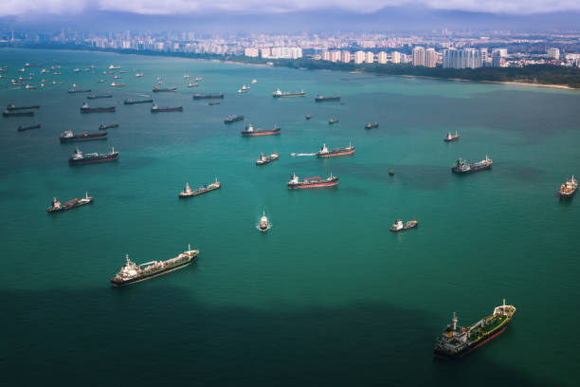
Hamnar och infrastruktur

Slide 36
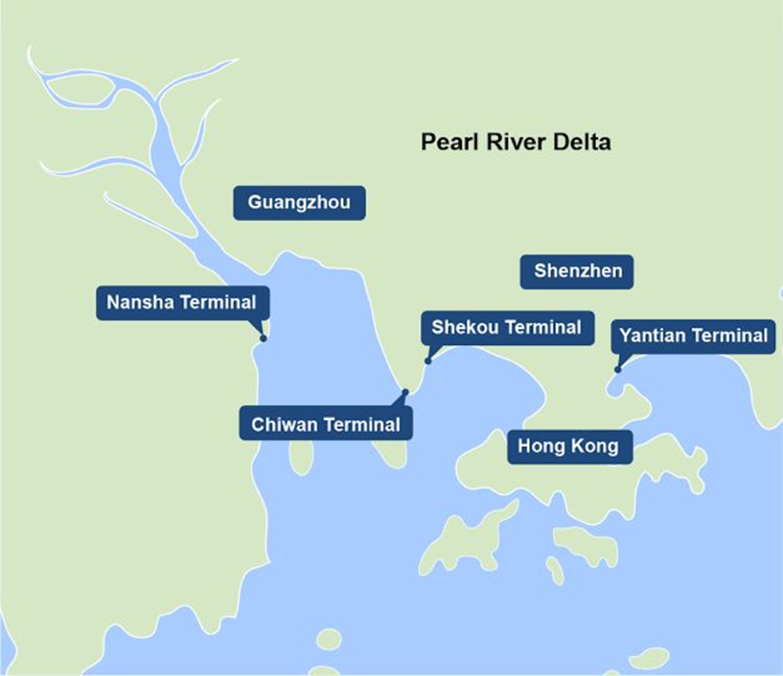
Ports and infrastructure
Shenzhen 27.7 million teus
Hong Kong 20 million teus
Guangzhou 21.8 million teus
Yantian 21.7 million teus

Slide 37
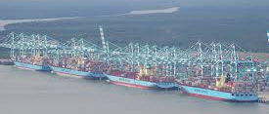
Ports and infrastructure
Singapore
37 million teu in 2021
90,000 ships
52 berths for container ships
Tanjung Pelepas
Maerk's Line
12, million teus
14 berths
58 taps

Slide 38
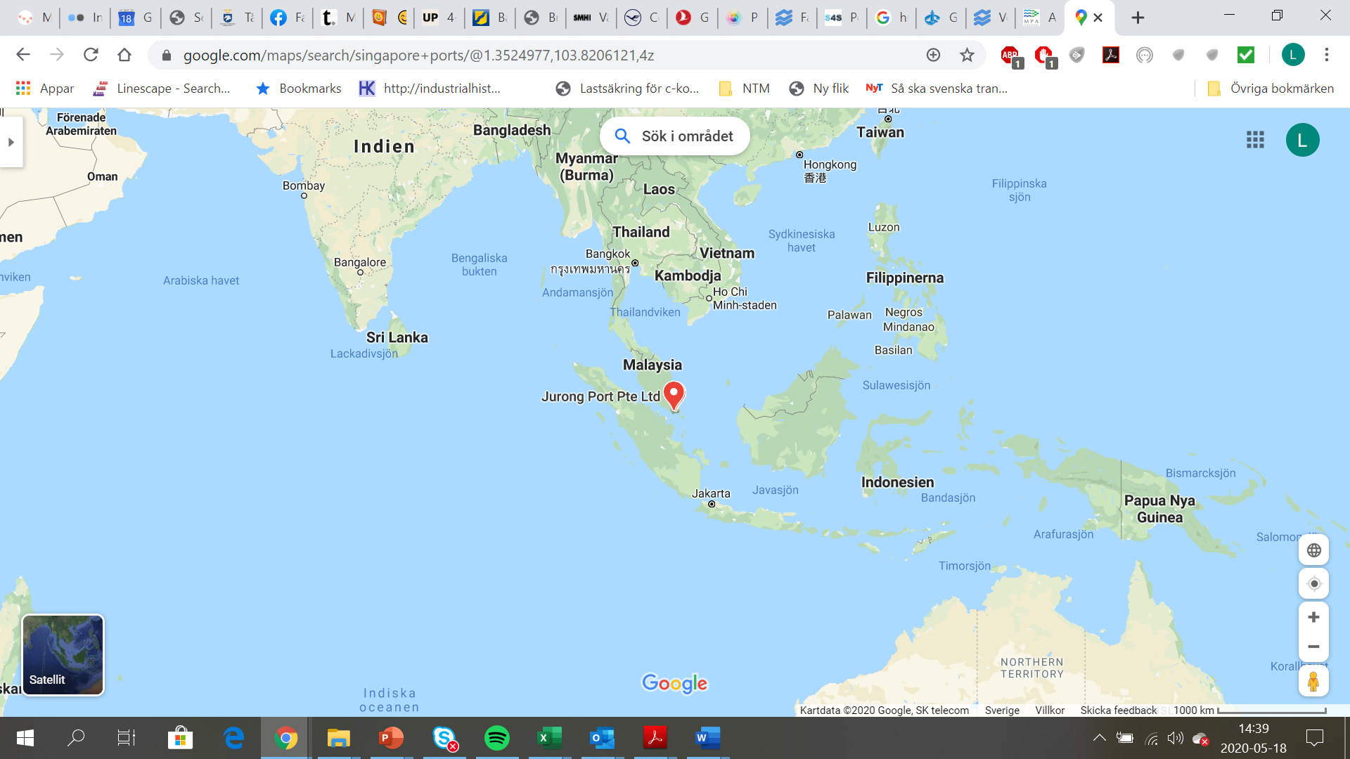
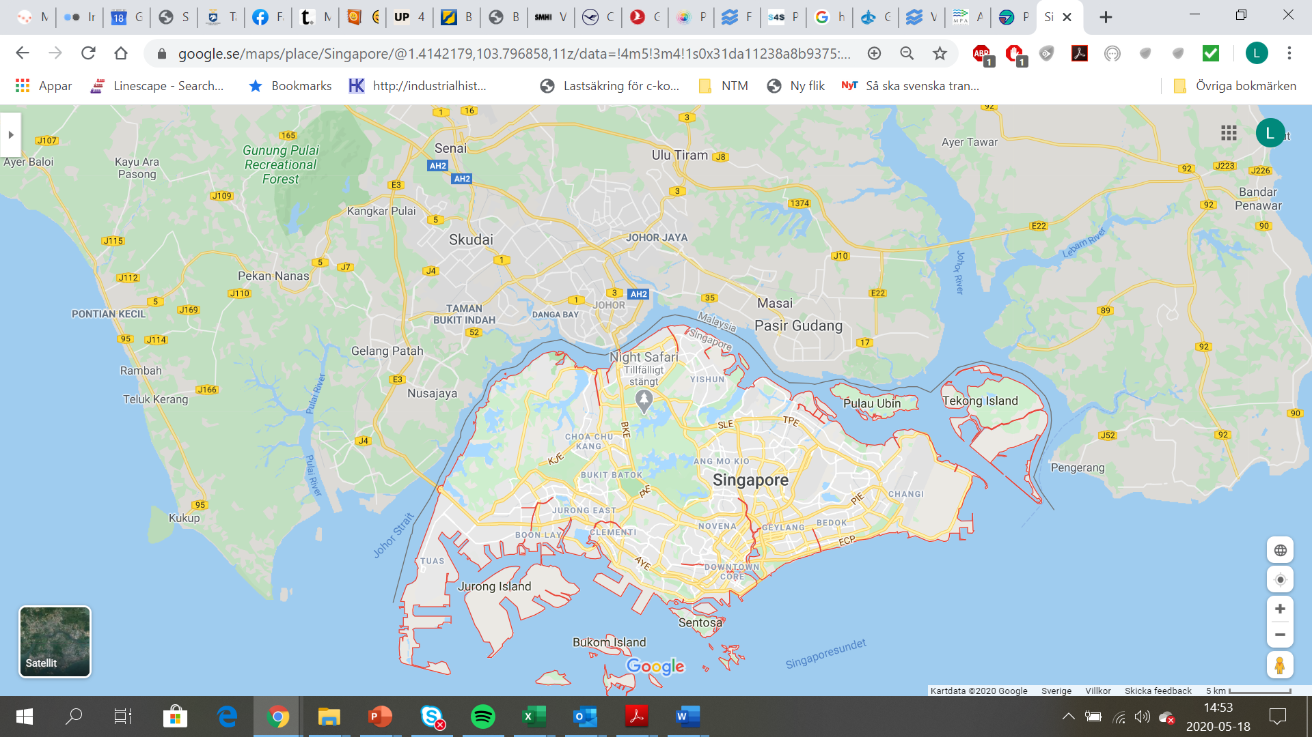
Singapore
Area: 719 km2
(Öland's area 1350 km2)
Inhabitants 5.6 million
Malaysia
Tanjung Pelepas

